Slide 1
INTRODUCING

Slide 2

CODE.AI
CODE ANALZER TOOL

Slide 3
TEAM MEMBERS
SANTHOSH S : +91 87920 05562
MAHALAKSHMI J
VIDHYA SATHYA MURTHY
NISHA YADAV

Slide 4
PROBLEMS
STUDENTS FACE DIFFICULTY IN:
UNDERSTANDING SIMPLE DSA LOGICS
DEBUGGING AND TRACING ERRORS AND LEARNING PATTERNS
HOW CRYPTO CURRENCY TRANSACTIONS ARE INTERGRATED IN REAL WORLD APPLICATIONS
STUDENTS DOESN’T HAVE A SAVE ENVIRONMENT TO PRACTICE CRYPTO TRANSACTIONS

Slide 5
SOLUTION
ANALYZES SOURCE CODE AND PROVIDE HUMAN LIKE EXPLANATIONS
PROVIDES WORKFLOW AND NEURAL NETWORK VIZULAIZATION
STUDENTS LOGIN USING WALLETS AUTHENTICATION
LEARN HOW REAL WORLD APPLICATION USE BLOCKCAHIN OR CRYPTO TRANSACTIONS FOR USER IDENTITY AND REWARDS

Slide 6
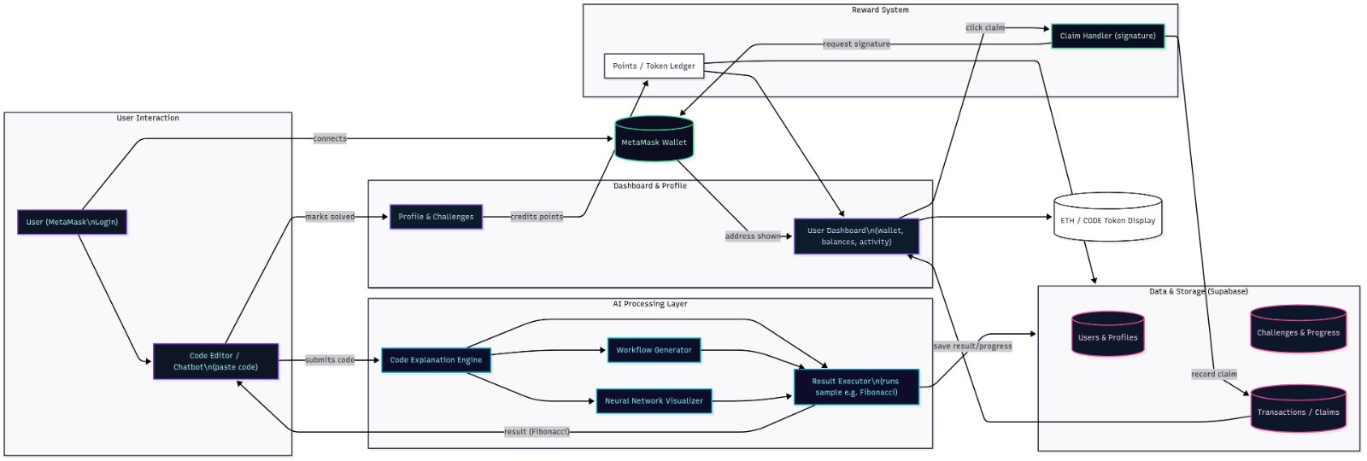
TECHNICAL ARCHITECTURE:

Slide 7
TECH STACKS
FRONTEND: HTML,CSS
SHADCN-UI
TYPESCRIPT
TAILWIND CSS
REACT
BACKEND: LANGCHAIN OPEN AI MODEL,
META MASK

